Slide 1

The ‘things’ of the Internet of Things?

Slide 2
Content
What sort of 'things' are we talking about?
Sensors and actuators
Lining up devices

Slide 3
What sort of 'things' are we talking about?
IoT streamlining mining operations
https://courses.edx.org/courses/course-v1:CurtinX+IOT1x+2T2018/jump_to/block-v1:CurtinX+IOT1x+2T2018+type@vertical+block@342e4bfb6ac64427854e7f4d12e31b05

Slide 4
Note
engine components
tire pressure
driver and a remote operation center
monitors
all machines and vehicles
a zero-harm environment for personnel and surrounding areas.
gas monitor systems
etc

Slide 5
What sort of 'things' are we talking about?
IoT case study: Dairy farm
https://courses.edx.org/courses/course-v1:CurtinX+IOT1x+2T2018/jump_to/block-v1:CurtinX+IOT1x+2T2018+type@vertical+block@f008e3228e6c46179f38027907fdf313

Slide 6
Note
all of the cows have a responder on them, which is a thing which has a motion sensor in it, and it also has a transponder in it.
milk meters

Slide 7
What sort of 'things' are we talking about?
IoT case study: Gait analysis
https://courses.edx.org/courses/course-v1:CurtinX+IOT1x+2T2018/jump_to/block-v1:CurtinX+IOT1x+2T2018+type@vertical+block@a5d71565dec641e487e02611aedab245

Slide 8
Note
a device using three separate IMU devices placed in three color coded 3D printed boxes. And the sensors will be attached to the different sections of the lower limb.

Slide 9
What sort of 'things' are we talking about?
IoT case study: Self-powering remote sensors
https://courses.edx.org/courses/course-v1:CurtinX+IOT1x+2T2018/jump_to/block-v1:CurtinX+IOT1x+2T2018+type@vertical+block@3fd7a317b9f8449090a2ae35bf7a55fb

Slide 10
Note
The equipment with its own power supply or battery supply or renewable energy--energy harvesting supply, and then have some means of digitizing that signature (embedded sensors).

Slide 11
What sort of 'things' are we talking about?
IoT case study: Autonomous bus
https://courses.edx.org/courses/course-v1:CurtinX+IOT1x+2T2018/jump_to/block-v1:CurtinX+IOT1x+2T2018+type@vertical+block@c96c2de1ee084e36add98abc04a09c82

Slide 12
Note
Autonomous bus: the wheel, stereo camera, GPS…

Slide 13
Sensors and actuators
Sensors in your smart phone
https://courses.edx.org/courses/course-v1:CurtinX+IOT1x+2T2018/jump_to/block-v1:CurtinX+IOT1x+2T2018+type@vertical+block@08fe79697d014d508a5f58421d8f7f4c

Slide 14
Note
capacitive
resistive
surface acoustic sensor
Magnetometer
Accelerometer
Gyroscope

Slide 15
Sensors and actuators
Actuators in your house
https://courses.edx.org/courses/course-v1:CurtinX+IOT1x+2T2018/jump_to/block-v1:CurtinX+IOT1x+2T2018+type@vertical+block@124d708d34e043eebe1e6c9673a2000f

Slide 16
Note
an actuator is a simple mechanism that moves or controls something:
Actuators operate in one of several ways. They are either:
Electrical
Pneumatic (uses air pressure)
Hydraulic (uses fluid pressure)
Mechanical

Slide 17
Lining up devices
Interactions: How bananas talk to trucks
https://courses.edx.org/courses/course-v1:CurtinX+IOT1x+2T2018/jump_to/block-v1:CurtinX+IOT1x+2T2018+type@vertical+block@4e72503a53574256b9f1c803602d50d2

Slide 18
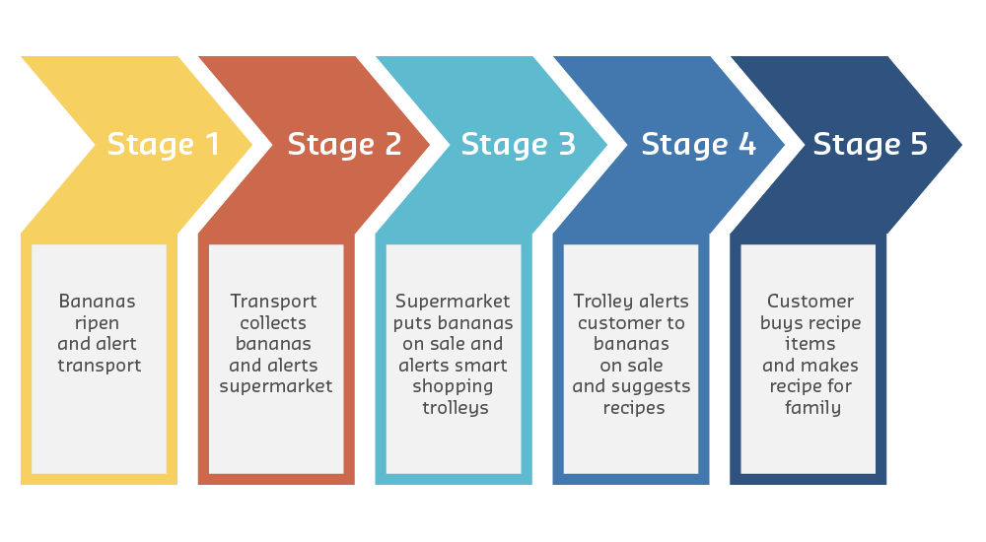
Note
The IoT-assisted banana supply chain
Decide whether each stage of the process is M2M, M2P or P2P.
M2M: Machine to machine
M2P: Machine to people
P2P: People to people

